Slide 1

Collection Framework
By Sanskar Modi

Slide 2
Collection Framework
A Java collection framework provides an architecture to store and manipulate a group of objects
Has many predefined methods like :-
Add() – to add elements
Remove() – to remove the elements
Has 3 main child interfaces (Set , List ,Queue)

Slide 3
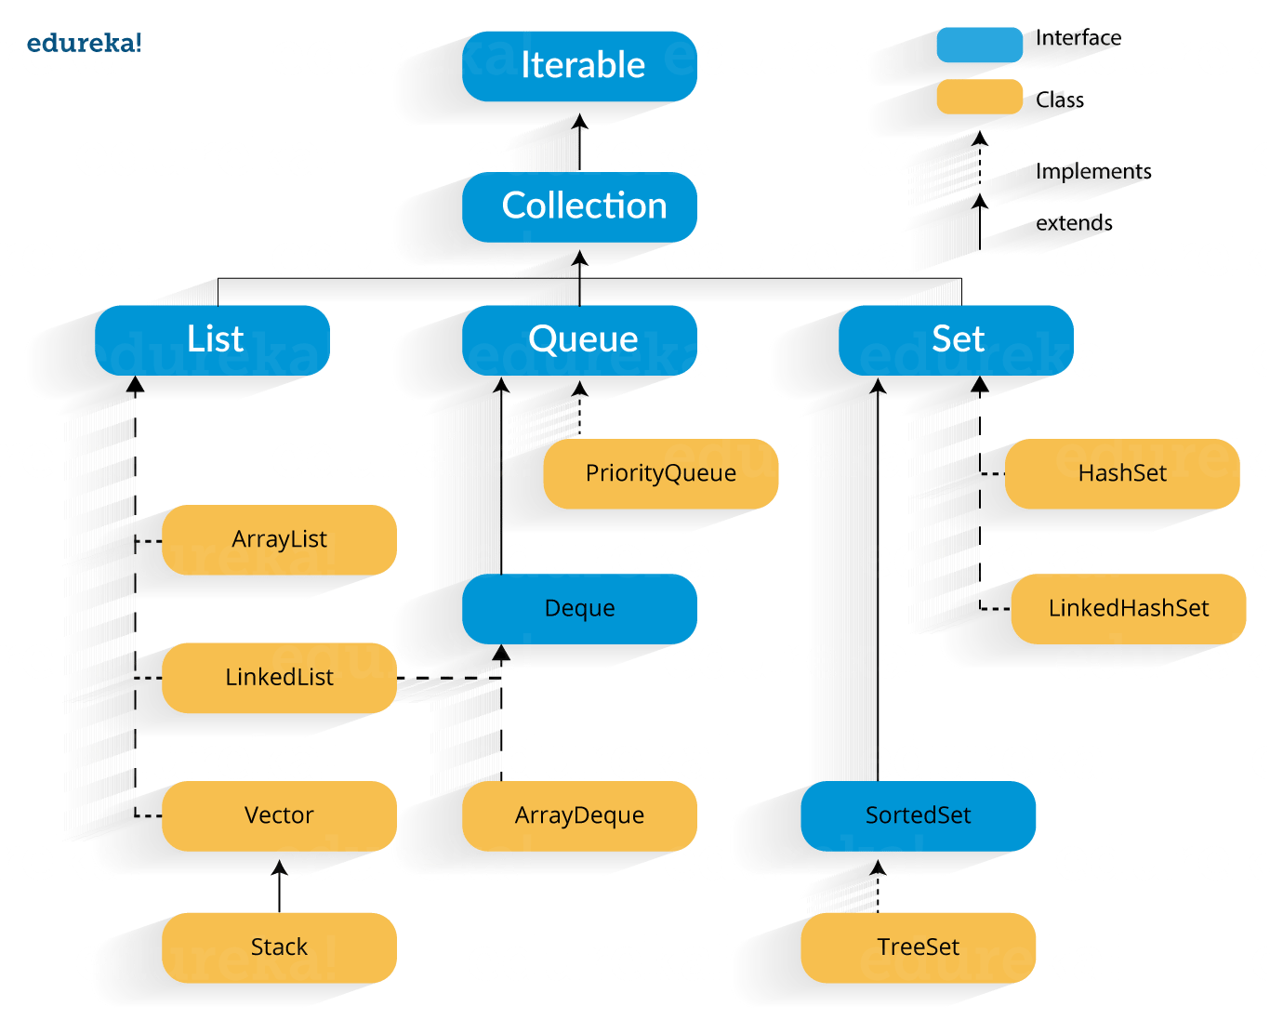
Classes and Interfaces In Collection Framework

Slide 4
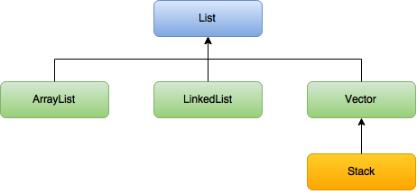
List Interface

Slide 5
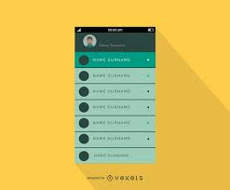
List Interface

Slide 6
List Interface
It is used to store multiple values
Has 4 Child Classes
Can Store duplicate data’s
Stores the element as per the insertion order

Slide 7
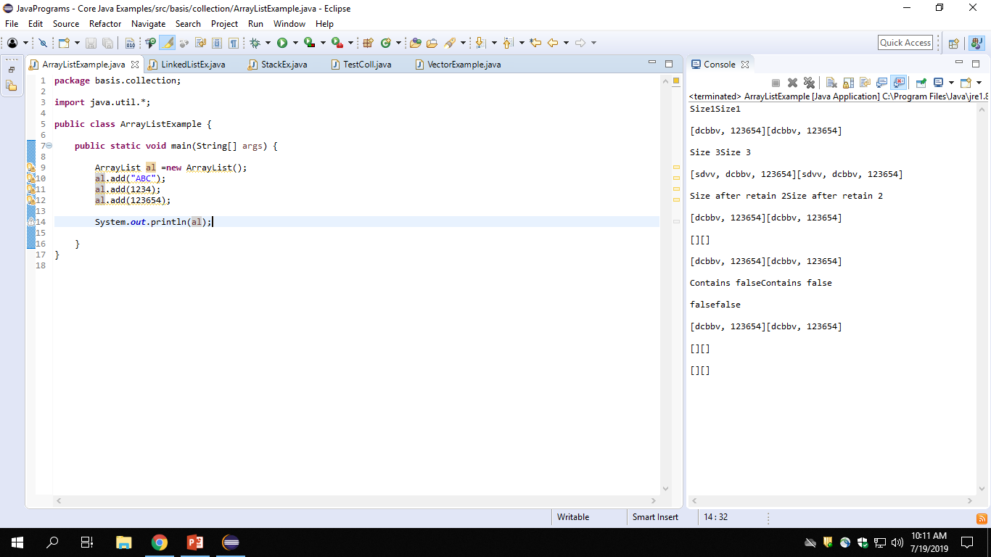
Array List Demo

Slide 8
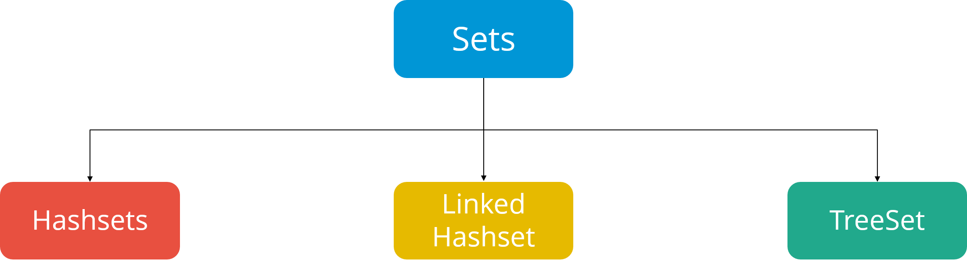
Set Interface

Slide 9
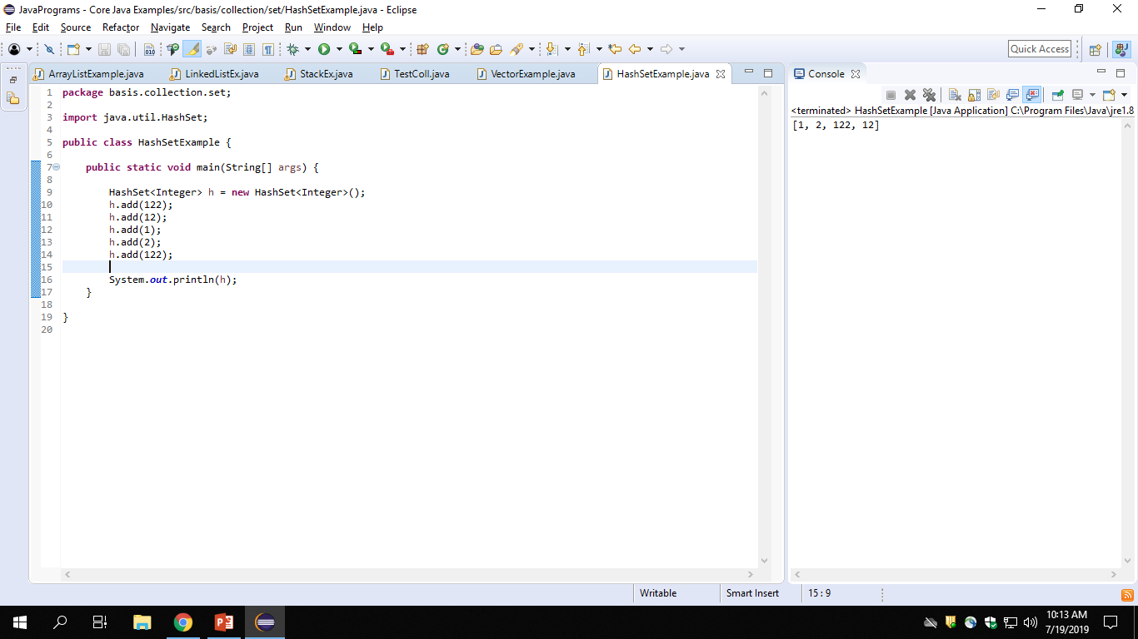
Set Demo

Slide 10
Set Interface
Has 3 child classes
Stores multiple values but doesn’t allows to store duplicate value
Doesn’t stores the value as per insertion order

Slide 11
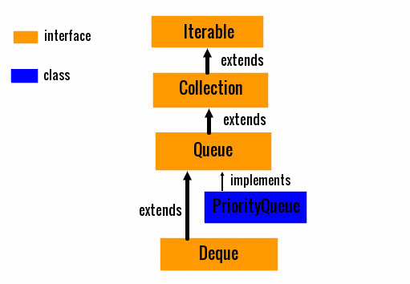
Queue

Slide 12

Queue

Slide 13
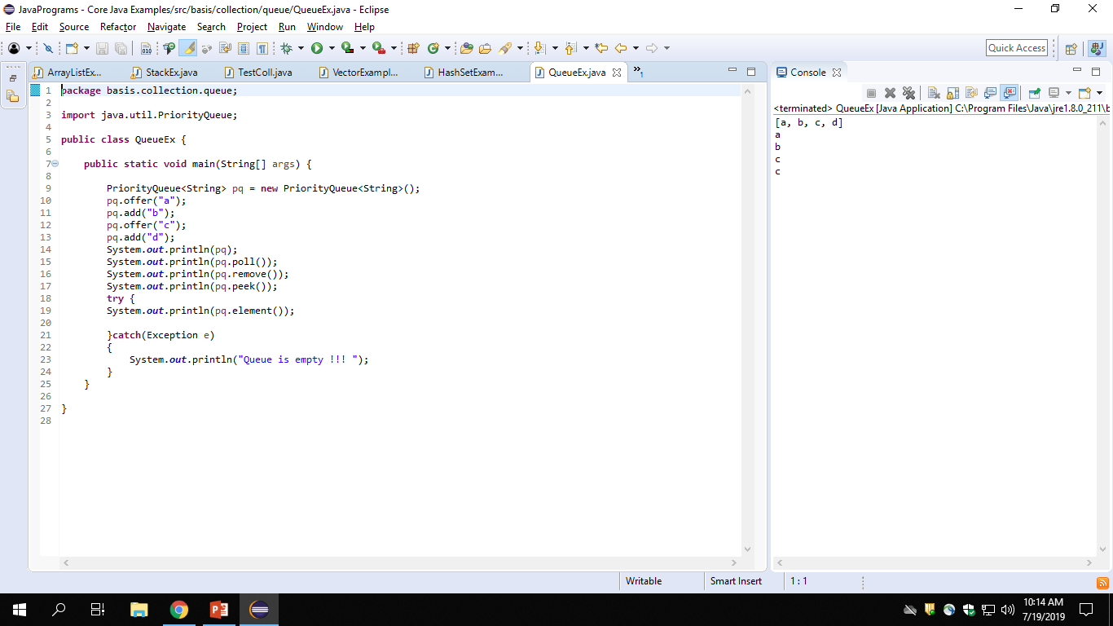
Queue

Slide 14
Queue
Works in FiFo(First In First Out) mechanism.
Stores multiple values
Has 2 child classes

Slide 15


